Slide 1
How to Create Your Own NETS Classification Category
- Columbia University Mailman School of Public Health RECVD Team

Slide 2
Category Background
NETS uses Standard Industrial Classification (SIC) codes as their native measure of business classification
It is often desirable to create business classes that go beyond what is described in SIC code (business name, number of employees, annual sales)
We have created a custom system of business categorization based on a number of different factors

Slide 3
Category Example: Pizza
A business can be categorized as a pizza restaurant if it meets EITHER of the following criteria:
SIC code is either 58120600, 58120601, or 5820602
SIC code is within either of these ranges (inclusive): (54110000:54999999, 58120000:58129999) AND the word “pizza” or “pizzeria” is in the recorded company name or trade name

Slide 4
Category Example: Fish Markets
A business can be categorized as a fish market if it meets the following criteria:
SIC code is in the range of 54210100:54210199

Slide 5
Categories: Important to Note
Categories can be built on a variety of criteria, and can be straightforward SIC code classifications or include other more complex criteria
Our native categories are not mutually exclusive by nature; a business can fit in more than one category

Slide 6
JSON (JavaScript Object Notation)
Pronounced “Jay-sahn” or “Jason” (disputed)
Derived closely from the description of objects in JavaScript
Easily parsed by computers and read by humans
We store our business class characteristics in a JSON file to keep it separate from the code that wrangles the data

Slide 7
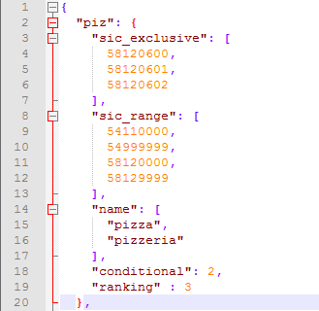
JSON Syntax Rules
Array
Object
JSON syntax is derived from JavaScript object notation syntax
Data is in name/value pairs
Data is separated by commas
Curly braces hold objects
Square braces hold arrays (lists of data, or objects)
Find more details and documentation on using JSON here
Data

Slide 8
Two Ways to Work with JSON
Desktop – Notepad++
JSON files can be opened using any text editor
Download Notepad++ here
Download and install the JSON viewer plugin here
This will perform text highlighting, check for syntax errors, and auto indent
Browser – JSON Editor
Downloadable from the Google Chrome app store
Create and edit JSON documents from your browser
Pro: Easier to setup and work with than Notepad++
Con: Can’t directly edit files on your machine without uploading/downloading

Slide 9
Defining Categories
Categories are built by one or more true false questions based on:
name -> Key word or list of key words corresponding to a given business category. True if the any of the key words can be found in the business name by using Python's business_name.find('keyword')
sic_exclusive -> A list of unique SIC codes. True if the business SIC code is located in the sic_exclusive
sic_range -> An inclusive range of SIC codes, or list of ranges. True if the business SIC code is within any of the sic_ranges
emp -> Number of business employees. True if the number of business employees is within the range explicitly specified by the category
sales -> Dollar amount of annual sales. True if the sales of the business is within the range explicitly specified by the category
sic_range2 -> same as sic_range, used if separate ranges apply to different parts of the conditional

Slide 10
Conditionals
Categories can use any number of combinations of the true/false questions we’ve described. A business belongs to a category if this Boolean conditional evaluates to True. These are all the combinations we’ve identified and used:
name
sic_exclusive OR (sic_range AND name)
sic_range
sic_exclusive OR sic_range
sic_range AND emp
sic_range AND (sales OR emp)
sic_range OR (sic_range_2 AND name)
sic_exclusive
sic_exclusive OR name

Slide 11
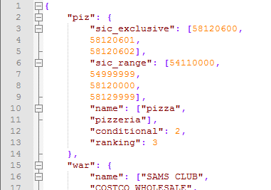
Examining a Category
Opening bracket
Category name
Let’s look at Pizza again, in json_config.JSON (the only file we’ll be working with)
Notice the “piz” object, and the other objects and arrays it contains
All categories don’t need all sub-objects. If it’s not relevant, just leave it out
Array
Represents two ranges: (5411:5499), (58120,:58129)
Closing Bracket ends category
Next category
Ignore
Tells the code how to evaluate the business against the category. Numbers correspond to those in the previous slide

Slide 12
Writing a New Category
New custom categories can easily be added if they are evaluated in the same manner as one of the existing conditionals, using the existing true/false questions
If you wish to base a category on a new conditional, this must be done by modifying the Python source code
For the purpose of this tutorial, we will assume you are using an existing conditional and true/false questions

Slide 13
Writing a New Category
It’s easy! First, develop the rules that define your category and which conditional they fit
Open json_config.JSON in either Notepad++ or your browser
Order is irrelevant in JSON, you may put the new object at any point in the file
Input all the true/false conditions relevant to your category, and its conditional type
Remember, Objects are enclosed in curly brackets. Arrays are enclosed in square brackets. Values are separated by commas.
Your JSON editor will be able to check your file for syntax errors
Save, and that’s it! The wrangling code now includes your category

